Slide 1
SALES ANALYSIS PROJECT – POWERBI
PRESENTATION by Aderonke diana Adeoye.

Slide 2
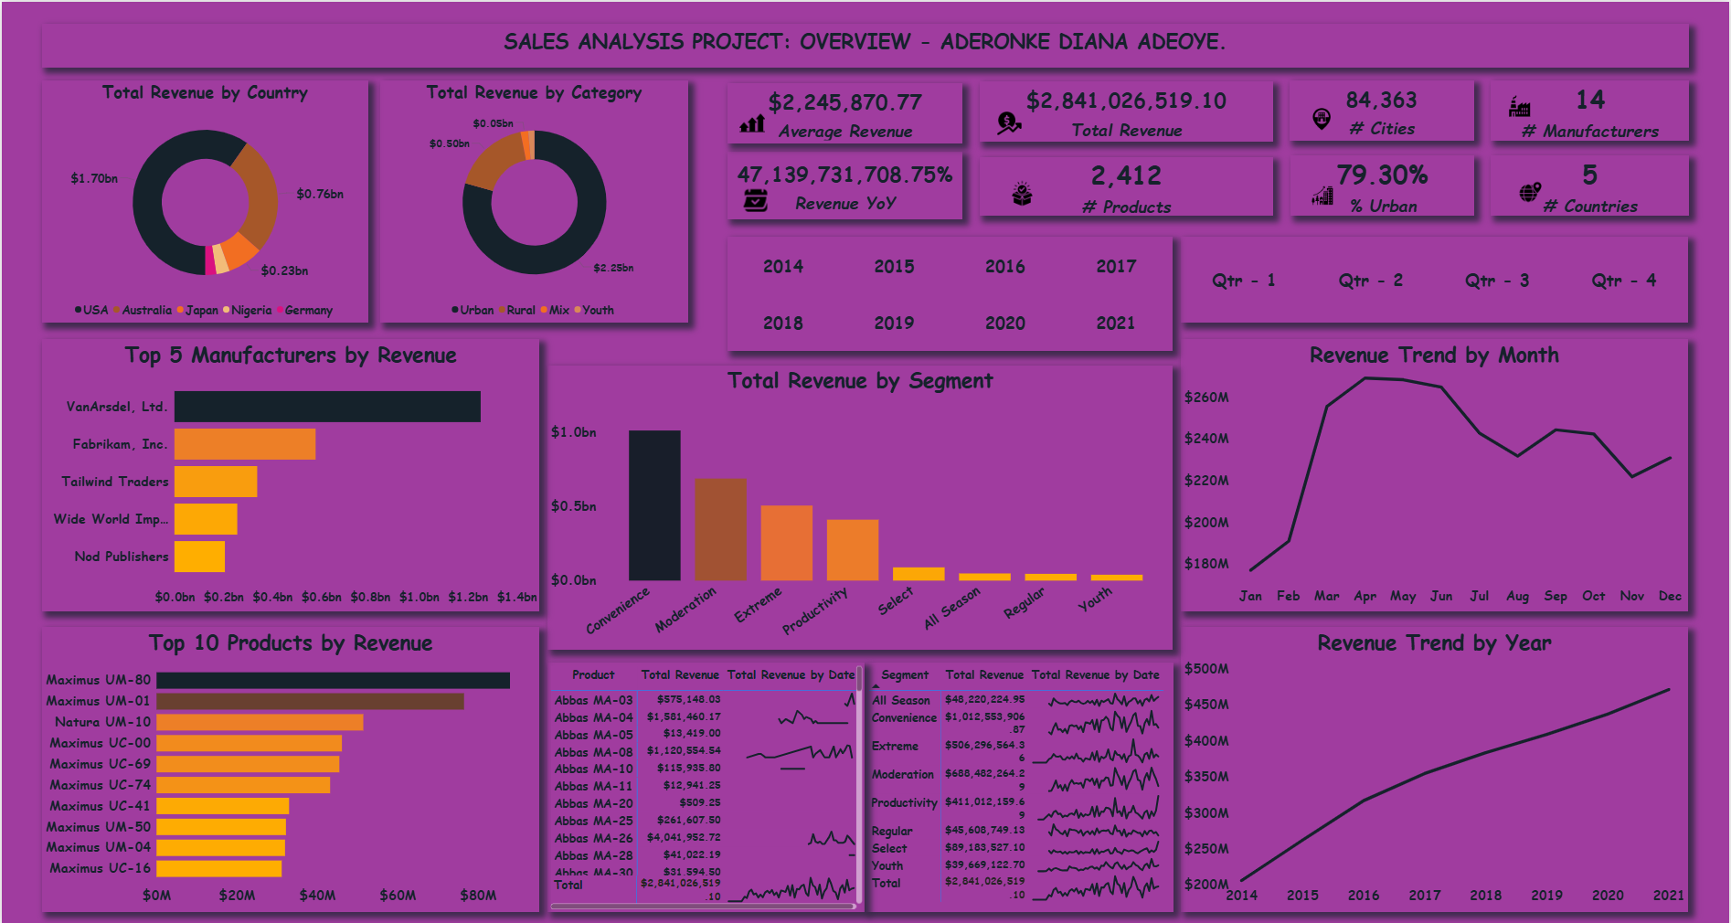
Overview.
Total Revenue.
Total number of Products.
Total number of Manufacturers.
% of Urban Revenue.
Number of Countries
Total number of Cities.
Revenue Trend by Year and Month.
Top 5 Manufacturers By Revenue.
Top 10 Products By Revenue.
Total Revenue By Category.
Total Revenue By Country.
Segment, Revenue, and a Sparkline of Revenue by Product.
Average Revenue.
Total Revenue by Segment.
Revenue YoY.

Slide 3
Problem Statement.
A multinational retail corporation is facing challenges in gaining comprehensive visibility into its global sales performance. Despite having extensive sales data across multiple countries, product categories, and customer segments, the organization lacks a unified analytical framework to derive actionable insights. Decision-makers are struggling to identify growth opportunities, optimize product portfolios, and understand geographic performance patterns due to the fragmented nature of data analysis approaches.

Slide 4

Methodology – Data Collection and Integration.
Data Integration: My tutor, Mr. Josh gave me the dataset for analysis. The sales dataset was extracted, transformed and loaded into the Power Query editor for comprehensive analysis.

Slide 5

Methodology – Data Cleaning and Preparation.
Handled missing or null values in the dataset.
Removed duplicate records.
Added and removed fields where necessary.
Corrected the datatypes.
Created the date table to track sales across board.

Slide 6

Methodology – Exploratory Data Analysis.
Conducted summary statistics to understand the data better.
Examined relationships among the various tables given. E.g. tables for Australia, Germany, Nigeria, USA, Japan, Geo, Products and Manufacturers.
Joined the related tables above by appending them together for a seamless analysis.

Slide 7

Methodology – Visualization and Insight.
Calculated measures to identify the various key performance indicators generated from the dataset.
Developed visuals for my dashboard showing the revenue trend by year and month, total revenue by category, total revenue by country, top 5 manufacturers, e.t.c.
Highlighted patterns using percentages and segment comparisons to uncover the highest sales revenue.

Slide 8
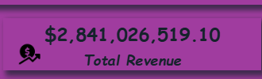
Total Revenue.
In this visual, it is evident that the company has a total revenue of $2,841,026,519.10 from their sales between 2014 to 2021 across 5 countries.

Slide 9

Total Number of Products.
Note that the company only sells 2,412 products with the top 10 being;
Maximus UM – 80.
Maximus UM – 01.
Natura UM – 10.
Maximus UC – 00.
Maximus UC – 69.
Maximus UC – 74.
Maximus UC – 41.
Maximus UM – 50.
Maximus UM – 04.
Maximus UC – 16
And the bottom 10 being;
Natura UR – 36.
Natura UR – 30.
Natura UR – 20.
Aliqui UE – 18.
Natura YY – 22.
Aliqui YY – 07.
Aliqui UR – 23.
Aliqui UR – 16.
Aliqui UR – 17
Aliqui MA – 14.

Slide 10

Total Number of Manufacturers.
The company has a total of 14 manufacturers with the top 5 being;
VanArsdel, Ltd.
Fabrikan, Inc.
Tailwind Traders.
Wide World Importers.
Nod Publishers.
And the bottom 5 being;
Adatum Corporation.
First Up Consultants.
Proseware, Inc.
Lucerne Publishing.
Consolidated Messenger.

Slide 11

Percentage of Urban Revenue.
From this visual, we can deduce that from the categories where sales are made across the countries, the urban generated a total of 79.30% of the revenue. This implies that the sales are the highest in the urban region. So, in order to have more sales, the other categories, i.e, rural and youth should be looked into as well.

Slide 12

Total Number of Countries.
This chart shows that sales are only made in 5 countries which are:
Australia.
Germany.
Nigeria.
Japan.
USA.
This means that, if we want to have a wider reach and make more sales, we should work on expanding our network and market to other countries of the world.

Slide 13

Total Number of Cities.
This chart shows that there is a total of 84,363 cities across the 5 countries where we make sales from. This implies that the number of cities can increase if we spread our tentacles across other countries.

Slide 14
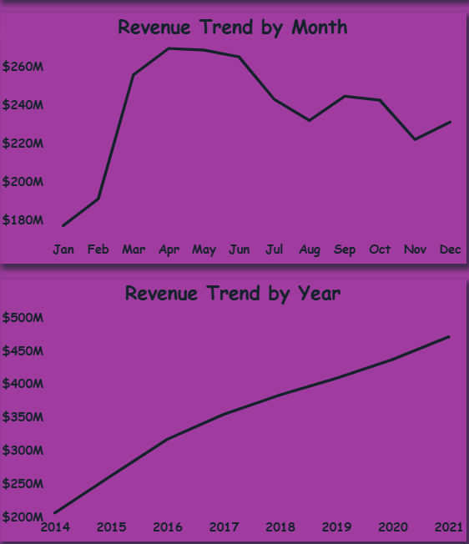
Revenue Trend by Month and Year.
This chart shows the revenue trend by month and year with a breakdown below:
In 2014, we had more sales in May with a revenue of $19,616,674.48.
In 2015, we had more sales in May with a revenue of $25,595,072.61.
In 2016, we had more sales in May with a revenue of $31,927,286.89.
In 2017, we had more sales in April with a revenue of $34,157,371.93.
In 2018, we had more sales in July with a revenue of $36,916,650.56.
In 2019, we had more sales in June with a revenue of $39,947,563.96.
In 2020, we had more sales in April with a revenue of $43,596,552.22.
In 2021, we has more sales in May with a revenue of $46,575,456.69.
This implies that we have the most sales during the second quarter of every year, and there is a significant increase in revenue every year.

Slide 15
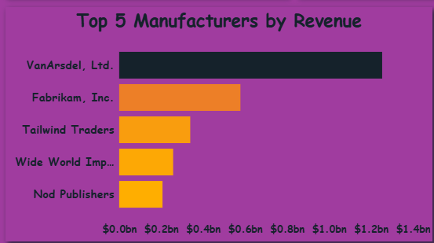
Top 5 Manufacturers by Revenue.
In this chart, we see the top 5 manufacturers by revenue to be:
VanArsdel, Ltd - $1,253,519,112.83.
Fabrikam, Inc - $577,906,134.01.
Tailwind Traders - $338,848,589.30.
Wide World Importers - $257,214,019.27.
Nod Publishers - $206,537,024.34.
It is also worthy to note that across the 8 years, VanArsdel, Ltd topped the chart.

Slide 16
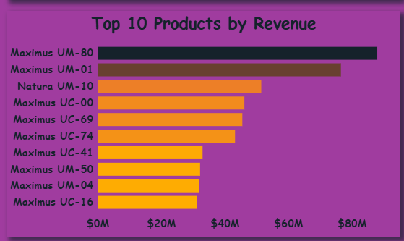
Top 10 Products by Revenue.
In this chart, we see the top 10 products by revenue to be:
Maximus UM – 80; $87,931,342.37.
Maximus UM – 01; $76,495,616.21.
Natura UM - 10 - $51,436,939.27.
Maximus UC – 00; $46,120,914.25.
Maximus UC – 69; $45,478,414.09.
Maximus UC – 74; $43,186,968.34.
Maximus UC – 41; $32,970,558.08.
Maximus UM – 50; $32,188,329.56.
Maximus UM – 04; $31,963,980.40.
Maximus UC – 16; $31,139,348.53.

Slide 17
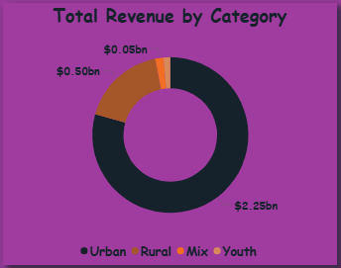
Total Revenue by Category.
This chart reveals to us that among the four categories, the Urban generates more revenue of $2.25BN for the company.
This shows that there is a poor reach to the other categories, which we have to look into immediately.

Slide 18
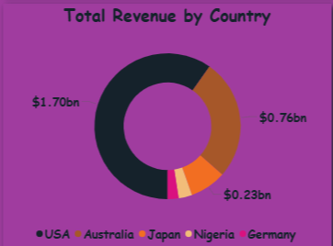
Total Revenue by Country.
This chart tells us that USA generated more revenue of $1.70BN for the company. Note that, USA topped the chart every year.
This implies that we need to focus on other countries where we are already making sales and see to it that they make more sales than they have been making.

Slide 19
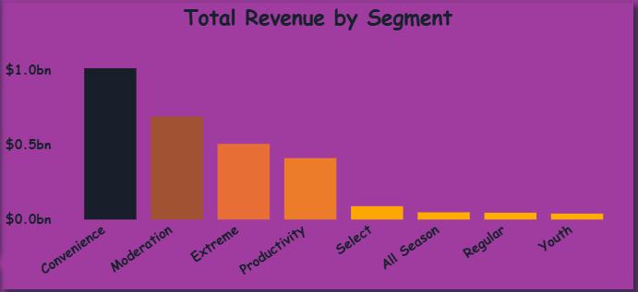
Total Revenue by Segment.
From this chart, we can see that the Convenience segment generated the highest revenue of $1,012,553,906.87.
Moderation - $688,482,264.29.
Extreme - $506,296,564.36.
Productivity - $411,012,159.69.
Select - $89,183,527.10.
All Season - $48,220,224.95.
Regular - $45,608,749.13.
Youth - $39,669,122.70.
Across the years, convenience topped the chart as the segment with the highest revenue.

Slide 20
Conclusion.
This Power BI sales analytics project successfully transformed raw sales data into an actionable business intelligence platform, providing comprehensive visibility into global sales performance across multiple dimensions. The dashboard delivers critical insights that enable data-driven decision making and strategic planning.
Key Achievements:
Developed 15 key metrics including total revenue, number of products, number of cities, average revenue, %urban, revenue trend by month and year, e.t.c.
Developed trend analysis with line charts, sparklines and dates.
Strategic Insights Uncovered:
Urban markets drive 79.30% of the total revenue.
Convenience segment drive $1BN total revenue.
Top products and manufacturers have been identified.
Least products and manufacturers have been identified.
Most sales across the years happen in the second quarter.

Slide 21
Recommendation.
Focus Resources on the Least Selling Products.
Bundle low selling products with the high selling ones as bonuses. For example, “Buy product A and get product B free or at a discounted price.”
Conduct customer surveys.
Run targeted social media ads to interested but unaware audiences and low performing cities.
2. Review and Monitor the monthly performances of the bottom 5 manufacturers.
Ultimately,
R - Reposition (Change perception).
I - Incentivize (Better Economics).
S - Support (Enhance Service).
E – Expose (Increase Visibility).

Slide 22

Gratitude.
Thank You.
I would like to express my gratitude to Mr. Josh for his valuable insights and teaching. I am glad to be your student.
Aderonke Diana Adeoye.

